Slide 1
LCD INTERFACING TO LPC1768

Slide 2
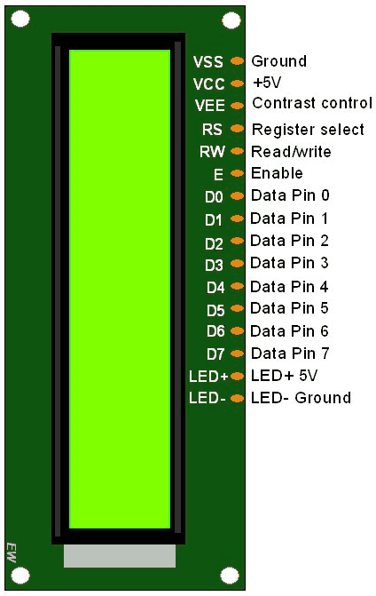
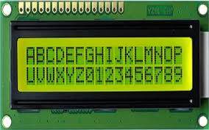
16X2 LCD: 2 ROWS WITH 16 CHARACTERS PER ROW

Slide 3
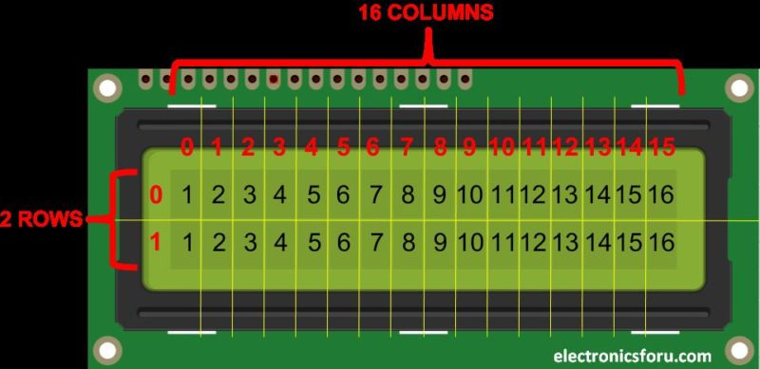
Each character is displayed as a 5x7 pixel matrix

Slide 4
Pins of LCD
RS : Register Select
RS =0 to select command register
RS =1 to select data register
Read/Write : High to low pulse needs to be given for every data/command write operation
D7 to D0: 8 bit pins used for 8-bit mode. Only D7 to D4 used for 4-bit mode
VEE: contrast control, voltage is varied using a potentiometer

Slide 5
